Slide 1
Integrated Systems and Safety Engineering Towards Meaningful Assurance Cases
Carmen Cârlan
Harald Ruess
Sebastian Voss
Supported by D-MILS (d-mils.org)

Slide 2
Assurance Cases
State-of-the-Practice (I)
Implicit assurance/safety cases are mainly supported by standard-mandated evidence (i.e. IEC 61508, ISO26262, DO178C)
Checkmark-based approach to safety engineering is encouraged, since the role/purpose of standard-mandated evidence often remains unclear
Example: Section B.30 of the IEC 61508 recommends the use of „formal methods for example CCS, CSP, HOL, LOTOS, OBJ, VDM, Z, B“ for SIL2 and beyond; and highly recommended for SIL4). These phrases were copied into the tender document for a drive-by-wire development, and relegated to a TIER2 supplier of a wheel angle sensor
Tailoring according to the specific safety-needs of the product difficult: unclear how to be best use avilable resources for increased assurance; also considerable impact on development costs
Not all design decisions necessarily explicated, as current certification regimes focus on traceability
Notes:
Mention Tier 1, how useful is MC/DC, existential threat …

Slide 3
Assurance Cases
State-of-the-Practice (II)
Explicit assurance cases (goals, arguments, evidence) not state-of-the-practice for developing safety-critical systems
Assurance cases with the purpose of certification, but not well-integrated into product design and development
Sometimes considered to be an extra document, if not extraneous from the point-of-view of the design team and the safety team.
What other uses are there for an assurance case?
Notes:
Industry: extra document, implicitly we are already doing this already,it is implicit in the processes. Might support communication between teams when making the reasoning graphically explicit.

Slide 4
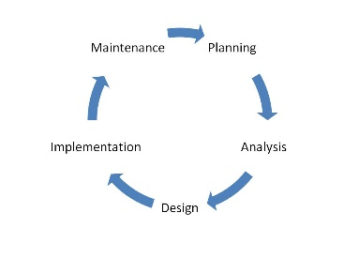
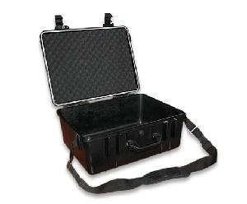
Assurance Cases
State-of-the-Practice (III)
SUCCESFUL DELIVERY
Developing a working system,
which complies with the
client‘s requirements
SUCCESFUL CERTIFICATION
Convincing regulators that
the system is safe
in the given context
Systems
& Software
Engineers
Safety
Engineers
Notes:
Reasoning – each of the stakeholders has separate reasoning, many design decisions are not explicitly documented
It is even worse than that: different testing team, security engineers.
Miscommunication among interfaces is one of the root cases of safety issues (next to unclear requirements)

Slide 5
Our Approach
Integrated Model-Based Development of Product and Assurance Case
Synchronization
by means of
Transformations
Systems & Software Engineers
Safety engineers
Model-based development approach with integrating views for a modular construction systems;
Modular construction and argumentation principles within these views, based on safety standards;
High-level design decisions and their documentation by means of safety case patterns.
Notes:
Based on claims given by (instantiated) safety case patterns, we use model-to-model transformations to guide the construction of a safe
system architecture.

Slide 6
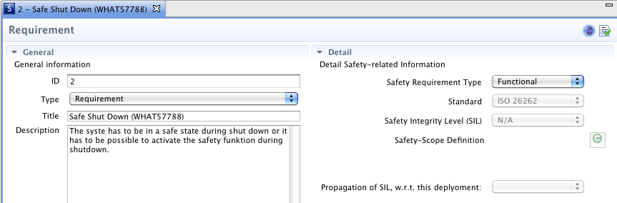
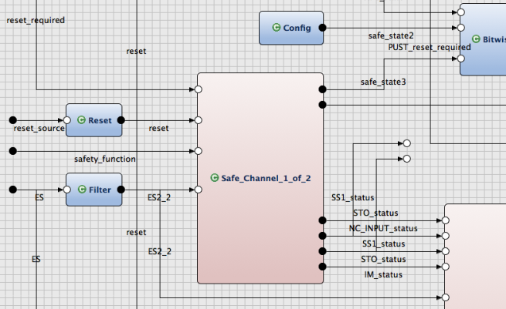
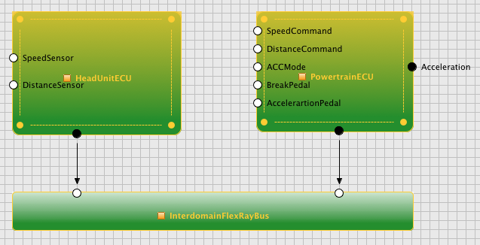
Model-based Development
Requirements
AF3 Framework
Logical Architecture
Supports concept phase and product development at system, hardware and software Level
Explicates allocations and refinements between different abstractions
Provides modular, hierarchic concept for networks of components
Can be simulated and formally verified
Supports automated verification
(e.g., contracts)
Supports automated generation
(e.g., test cases, code, platform
configurations, schedules)
Deployment
Technical Architecture
Notes:
We demonstrate the feasibility of the introduced approach by implementing it in the AutoFOCUS3 framework (a model-based tool to seamlessly specify embedded systems
in different layers of abstraction, while supporting different views on the system model), illustrating how integrated model-based design and safety cases forms a convincing
argument in a seamless model-based development environment.
Modular Construction of safety-critical (sub-)systems at dierent levels of abstraction

Slide 7
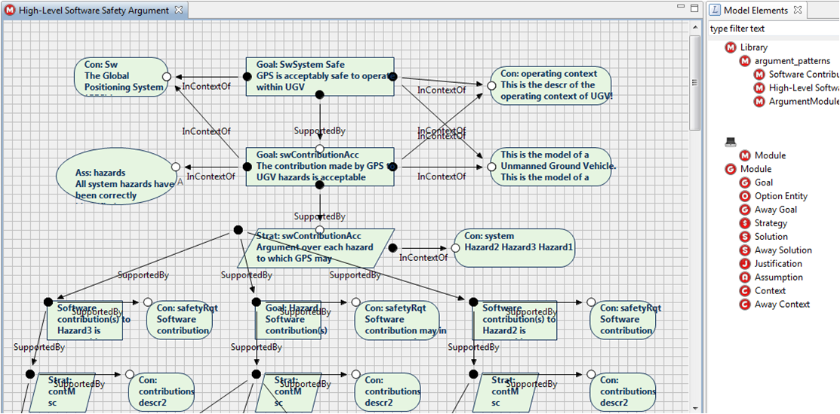
GSN-based Assurance Cases in AF3
The Argument Structure View
GSN model elements

Slide 8
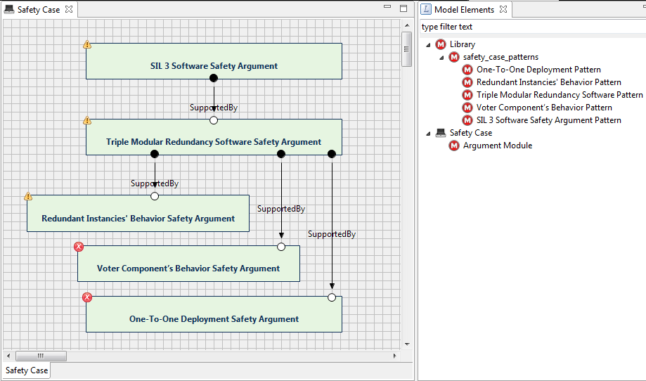
Modular Assurance Case Patterns
Library of Assurance case patterns
Pattern instantiation provides references in assurance cases to corresponding system artefacts
… as the basis for integrated views for the design of a system and the argumentation about its functional safety

Slide 9
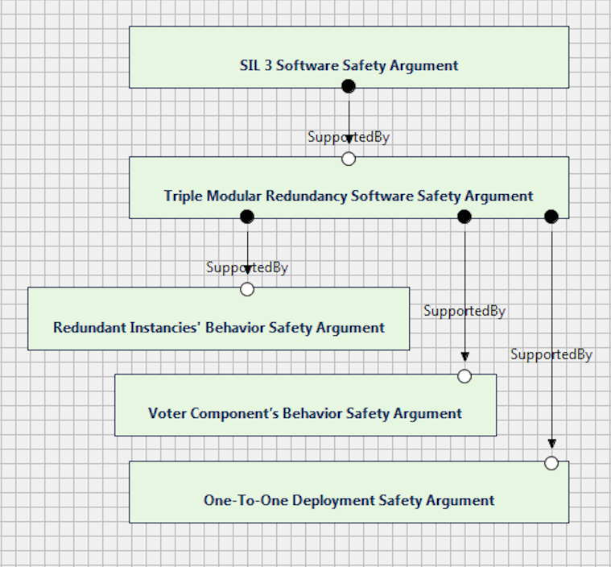
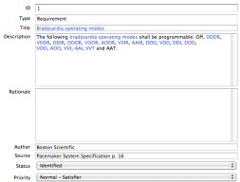
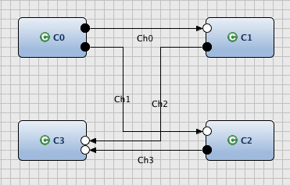
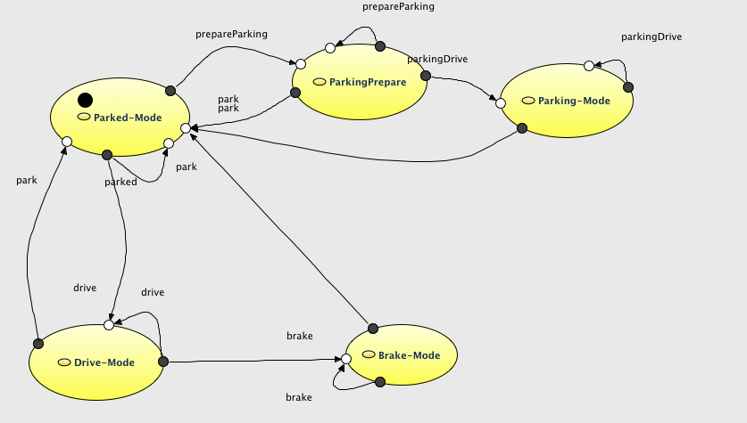
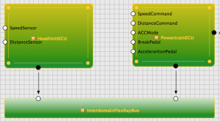
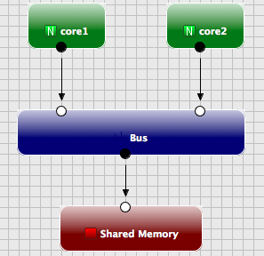
Integrated Development of System and Assurance Case
Requirements
High-Level
Assurance Argument
Synchronization
by means of
M2M
Transformation
Software-related Assurance Argument
Component Architecture
Deployment-related assurance argument
Deployment
Technical Architecture
Hardware-related
Assurance Argument
System Design Artefacts
Modular System Safety Case
[VCST15] S. Voss, C. Cârlan, B. Schätz, T. Kelly, Safety Case Driven Model-Based Systems Construction, EITEC, CPS Week, April 2015, Seattle.
Notes:
e.g. Architectural Refinement, for example by means of TMR, leads to instantiation of corresponding safety case patterns
e.g. Collecting safety constraints from safety case as input to the platform deployment

Slide 10
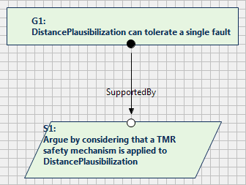
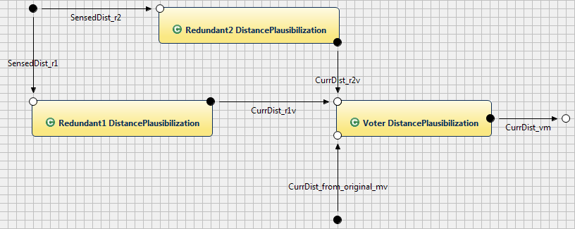
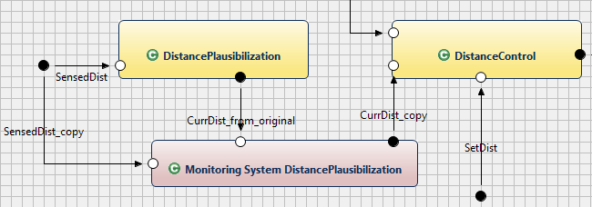
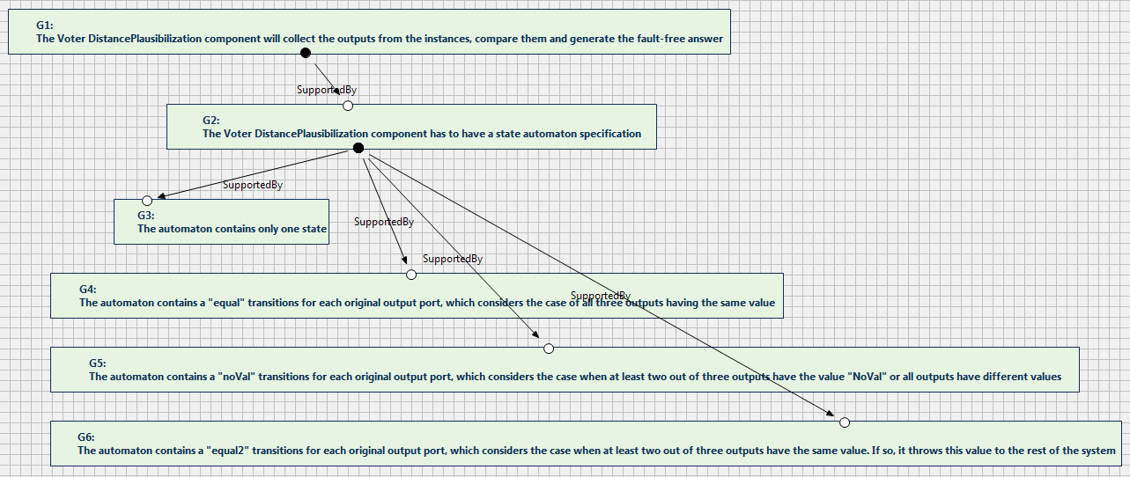
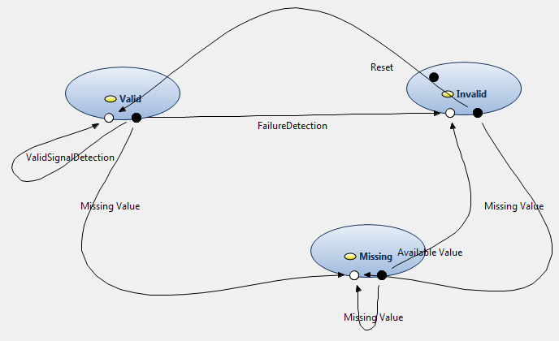
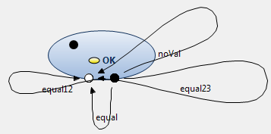
Example 1
Deciding on Appropriate Architectural Design
Requirements
High-Level
Assurance Argument
Component Architecture
Software-related Assurance Argument
Deployment
Deployment-related assurance argument
Technical Architecture
Hardware-related
Assurance Argument
System Design Artefacts
Modular System Assurance Case
Notes:
Safety Case may provide constraints on deployment to technical platform. By going through those constraints, if the system developers proposed during design 2 or more deployment models,
One can choose from those models, by taking the model which is conformant with the constraints from the safety case

Slide 11
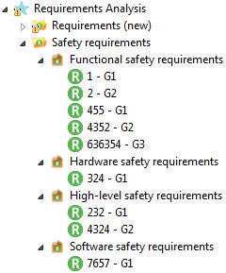
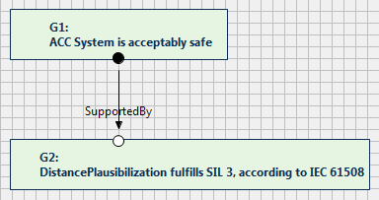
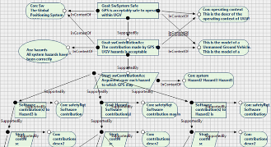
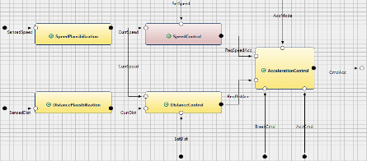
Example 2
Architectural Refinement by Means of TMR Transformation
Requirements
High-Level
Assurance Argument
Component Architecture
Software-related Assurance Argument
Deployment
Deployment-related assurance argument
Technical Architecture
Hardware-related
Assurance Argument
System Design Artifacts
Modular System Safety Case
Notes:
For example, if the safety engineer decides at some point to go further into the argumentation of the safety of the system by applying a strategy which indicates the usage of TMR design strategy for a certain system component in order to assure a fault tolerance of one and to be complaint with the regulations. This would mean that he needs to communicate with the system engineer to make sure that this certain design strategy has been/will be applied to the respective system component. However, our approach allows the system architecture to evolve automatically in correspondence with the strategies the safety engineer wants to apply.

Slide 12
MILS Architectural Assurance Case Pattern
Example 3
Autofocus
Model
Simulink
Model
Security Analysis
Safety Analysis
Performance
Analysis
Autocode
Autocode
C
Code
C
Code
Ada
Code
Implements/
Satisfies
D-MLS Technical Platform
App A
Level B
Classified
App B
Level C
Unclassified
App C
Level A
Top Secret
Architectural Refinement
MILS
AADL
MILS
AADL
MILS
AADL
Configurations / Schedules / Communication Routes
Node1
Node2
Node3
A
B
MILS Platform
Configuration
Compiler
C

Slide 13
MILS Architectural Assurance Case Pattern (II)
Example 3
SuC satisfies security/safety goals
MILS
Architectural Strategy
Architectural description (in MILS-AADL) satisfies security/safety goals (in LTL)
Correctness of
Architectural Refinement
Application Code
satisfies / implements
architectural constraints
Architectural information flow policy
implemented correctly
on technical platform
AND
OR
AND
Architectural Transformations respect refinement relation
MILS Platform configuration as generated by the MILS Platform configuration compiler exactly implements architectural information flow policy
Technical Platform under consideration satisfies MILS SKPP (including isolation, flow control policy, determinism)
Model Checking
Run-time
wrapper
Formal
Verification
Application-Specific
OR
Safety & Security goals preserved under architectural refinement
Testing
MILS Platform Configuration Compiler formally verifed
Isomorphism between configuration& architectural information
flow
Technical platform is verified to satisfy SKPP
Once and forall

Slide 14
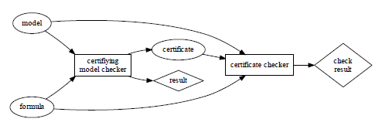
Example 4
Certifying Model Checker For Building Assurance Cases
Model Checkers (MC) usually only output counterexamples on failed proof attempts.
Counterexamples have been used to construct FTA and FMEA in an automated fashion.
Certifying MC produce independably checkable certificate
Certifying MC for mu-calculus (including CTL, CTL*, LTL,…) with winning strategies for corresponding games as certificates [HNR15]
Certificates may be computed for both safety and liveness properties from MC
Winning strategies are checkable in low polynomial time
Winning strategies may be used to scrutinise safety arguments a la interactive proofs
Challenger suggests a move, to which Prover responds with a move according to strategy, and so on, …
[HNR15] M. Hofmann, C. Neukirchen, H. Rueß, Certification for mu-calculus with winning strategies, submitted to ICTAC 2015.
Notes:
….

Slide 15
Integrated System and Assurance Case Development
Potential Benefits
Assurance cases decompose along vertical and horizontal structure of system design artefacts
Assurance case may guide safe and efficient system development
Architecture-centric approach provides opportunity for high-level assurance patterns (e.g. MILS) for reducing the effort of building up safety cases
Certifying model checkers for automatically generating formally checkable evidence in assurance cases
Assurance case may extend, and even replace, the traditional syntactic tracing („depends-on“) with a semantic tracing („why?“) capability
System may safely (self-) evolve/adapt within the limits of the capability of adapting corresponding safety case(s)

Slide 16
Conclusions
Presented first steps towards realizing integrated system development and its corresponding safety case in the AF3 model-based framework
Approach needs to be formalized with the goal of having M2M transformations and also deployment formally verified (e.g. PVS)
More complete catalogue of transformations (e.g. architectural refinement by means of fault-tolerance patterns) needed
Refine MILS architecture-specific assurance case patterns and implement as transforimation in AF3
Approach needs to be validated by means of realistic case studies
Notes:
Model-based design using dedicated precise models { or more precisely, dedicated
views on an integrated model of the system under development { are key enabler
to increase the usability of safety cases. We have shown how model-based system
design can be tightly integrated with safety case arguments to automatically
guide the construction of the system architecture w.r.t. the claims given in the
safety case. We demonstrated how model transformations can be used in that
respect.

Slide 17
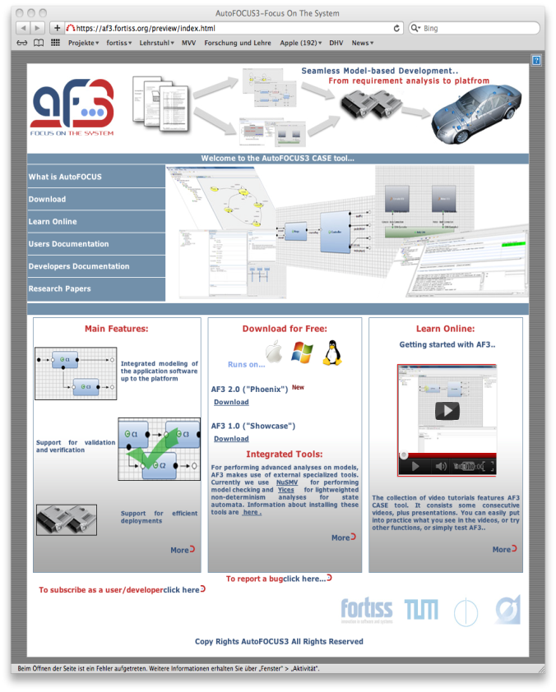
AF3 – Try it out!
Eclipse Public License
af3.fortiss.org

Slide 18
„… how much better will it be to bring under mathematical laws human reasoning, which is the most excellent and useful thing we have“. (Leibniz)
Harald Ruess
ruess@fortiss.org
fortiss GmbH
An-Institut Technische Universität München
Guerickestraße 25 · 80805 München · Germany
tel +49 89 3603522 33 fax +49 89 3603522 50
www.fortiss.org

