Slide 1
Value Assurance Cases
Kevin Sullivan, UVa CS (Koleman Nix, Ke Dou, Chong Tang) collaborators: Barry Boehm, USC; Adam Ross and Donna Rhodes, MIT Work supported by NSF CMMI-1400294 and SERC, Opinions are those of the author only

Slide 2
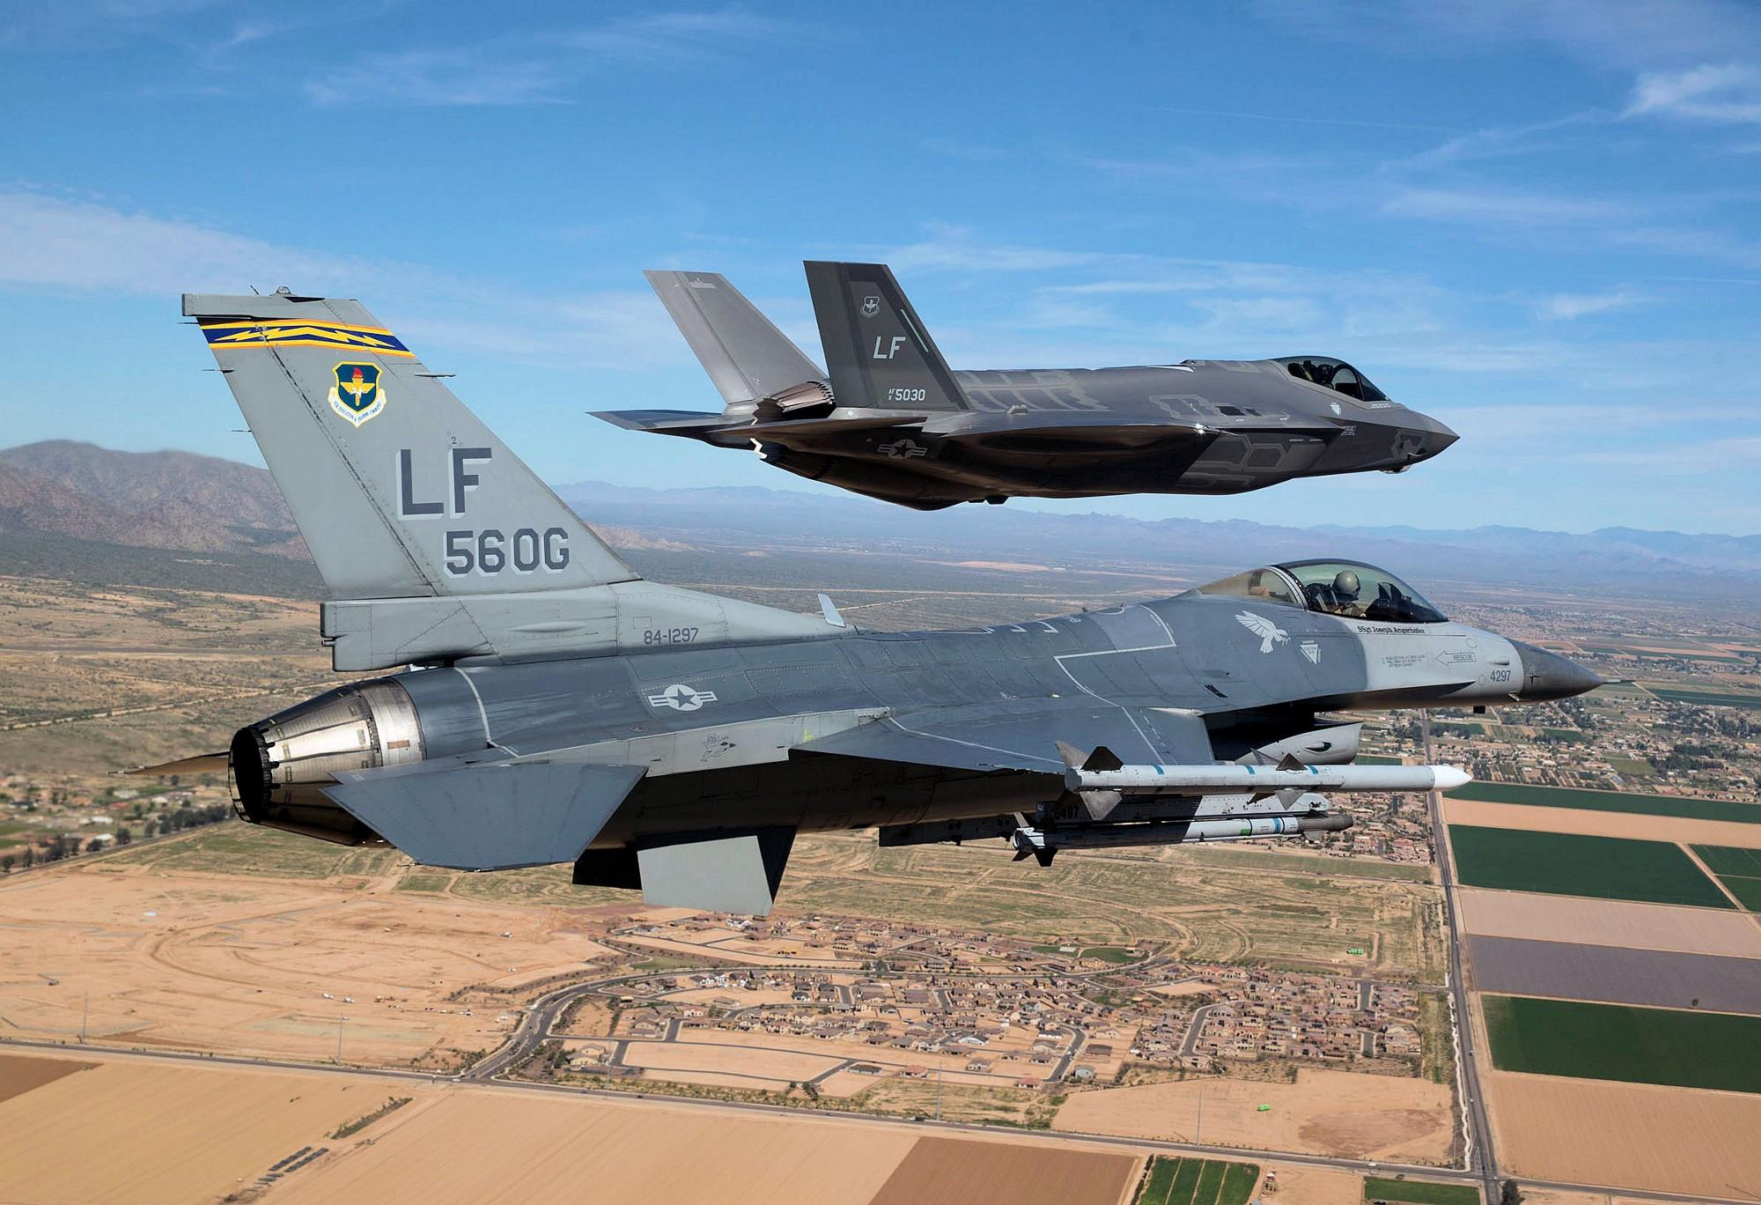

Slide 3
Recent Report on Pilot Testing
$1,500,000,000,000.00 est. TCO
Recently leaked FOUO test pilot report
Clean F35 vs. F16 with double drop tanks
“... focused on ... effectiveness in performing ... maneuvers in dynamic environment”

Slide 4
Pilot-Reported Results
The F35 “can’t turn or climb fast enough to hit an enemy plane during a dogfight or to dodge the enemy’s own gunfire”
The “... F-35 was at a distinct energy disadvantage”
The F35 exhibited an “...insufficient pitch rate”
The F35’s “... energy deficit to the bandit would increase over time”
“The flying qualities in the blended region... were not intuitive or favorable.”
“... the nose rate was slow, allowing [the F16] to easily time his jink prior to a gun solution”
“The helmet was too large for the space inside the canopy to adequately see behind the aircraft”
WIB report finds F35 “demonstrably inferior in a dogfight with the F-16”
AF: “The F-35's technology is designed to engage, shoot, and kill its enemy from long distances, not necessarily in "dogfighting …” (Um.)

Slide 5
Massive failure of value assurance?
Has anyone been killed by lack of “safety”?
Pilot fatalities in F35 mishaps to date = 0
Potential waste of $1T is a stunning hazard
Value destruction scale profoundly harmful
Hunger, education, drug addiction, roads, …
F35 is hardly the only program of this kind
Service without unacceptable losses is key
We need comprehensive value assurance

Slide 6
Value flows from full range of system properties
Affordability, resilience, dependability, mission effectiveness, flexibility, modifiability, security, safety, reliability, availability, maintainability, survivability, robustness, cost effectiveness, timeliness, availability of and efficiency in the use of key personnel and other resources, manufacturability, sustainability, physical capability, cyber capability, usability, speed, endurability, maneuverability, accuracy, scalability, versatility, interoperability [Boehm’s top-level taxonomy, 2015]

Slide 7
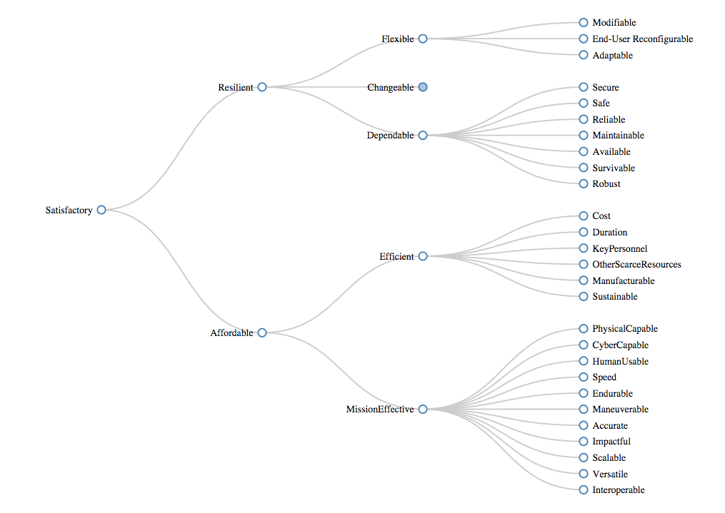
Based on Boehm and Kukreja, An initial ontology for system qualities, INCOSE 2015, Seattle, July 13-16, 2015. (Top level only.)

Slide 8
Major challenges in value assurance
Engineers over-focused on functional decompositions
Poor ability to manage full range of system properties
non-functional system properties
diverse stakeholder value propositions
complex tradeoffs among system properties and stakeholder value
Poor ability to specify system properties
mature science in areas such as reliability
immature in flexibility, resilience, performance, etc
what do these terms mean, and how do we articulate requirements?
Poor ability even to define system properties
Unacceptable lack of value assurance across life-cycle

Slide 9
Goals of this research effort
Value assurance structures and processes as essential systems engineering capability and responsibility
Formalize, automate definitional property taxonomies
Parameterized by system models, property-specific languages for specification of all critical properties
Proof engineering to automate certificate management for engineering management
Accommodate as broad a range of systems, properties, analyses, evidence as possible while remaining formal
Accommodate proofs as, or any other kind of, evidence

Slide 10
Approach
Coq as language and proof assistant
ease of embedding specialized languages
extraordinary expressiveness of CoC
automated proof engineering
polymorphism, typeclasses, dependent types
Definitional hierarchy of top-level qualities rooted in value
Parameterized by comprehensive system model
Leaves universally quantify over families of specifications, written in pluggable property-specific little languages, and varying by stakeholder, context, phase, etc

Slide 11
System Model: parameterized by stakeholders, value metrics, contexts, phases, product models
Forall stakeholders s, contexts c, phases p, adaptable s c p. adaptable is system- specific family of specs written, in a property-specific sub-language (e.g., one in which one can talk about the costs of change using metrics)

Slide 12
External content inserted here

Slide 13
Summary
Taxonomy parameterized by system type
System parameterized by contexts, stakeholders, etc
Arbitrary system models, mathematics
Suites of property-specific little languages
E.g., hazan handled in dependability langs
Proof automation for certificate management
Mechanism for property management

Slide 14
Planned work
Need modern theory/evidence evolution environments
From cases to assurance systems and processes
Research projects around numerous little languages
Prototype tools and evaluation in engineering practice
Value assurance cases as evolving scientific theories
But it’s a Science of the Artificial, so when our theories fail, we can change the theory, or change the system!
Value assurance as a basis for lifecycle management

