Slide 1
Toward
Practical Use of Assurance Cases:
Definitions, Methods, and Tools.
Nihon University
Yutaka Matsuno
matsuno.yutaka@nihon-u.ac.jp

Slide 2
Contens
D-Case Project – Assurance Case Project in Japan
AC Working Library in Japan
Tool
Concluding Remarks

Slide 3
D-Case Project
Assurance Case Project in DEOS (Dependable Embedded Operating System) project funded by Japan Science and Technology Agency (2010-2015)
  D: Dependability
DEOS Consortium D-Case Working Group
  Nihon U、Nagoya U、Fuji Xerox、Naist、Tokyo U、Denso Create、Change Vision、Mitsubishi、Aizu U、 …

Slide 4
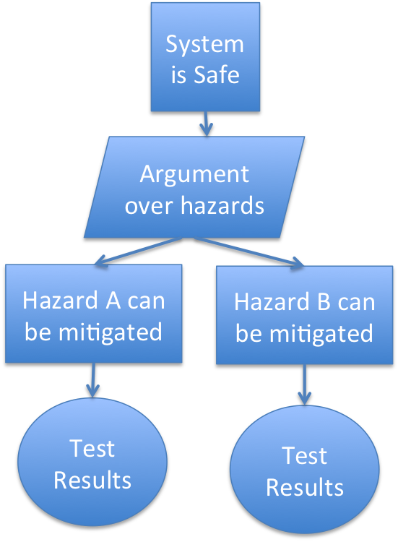
Assurance Cases
Recognized after serious incidents such as Piper Alpha (1989)
Wrote AC in GSN for a demo system (2009)
  Japanese Industry Expected AC as a common language inside and between companies
Identified Hazard: A,B
Set Assumptions
Set A Goal
Set Argument Way
Very Familiar
In
Computer Science!
Divide into
Sub goals
Put sufficient Evidence

Slide 5
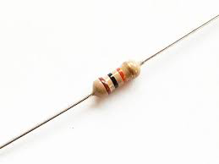
Challenges of AC
When, who write and evaluate?
Claim and argument structure setting
  System is acceptably safe, dependable,…
  Argument over lifecycle phases, system structure?
Granularity、Size
  Write reliability of a resister?
  System becomes huge → AC becomes huge?
Most challenges were unsolved,
so we started D-Case Project

Slide 6
Contens
D-Case Project – Assurance Case Project in Japan
AC Working Library in Japan
Tool
Concluding Remarks

Slide 7
AC working library in Japan
Over 50 ACs in GSN since 2010, www.dcase.jp
Size
  10 - 200 nodes, Ave. 63.5 (SD: 47)
  2 - 6 Depth, Ave. 4.1 (SD: 1.03)
Contents
  Fault Tolerance AC
    DEOS Demo System
  System Safety, Dependability AC
    ISO26262、Automotive、Micro Satellite、
  Situational AC（Specific Context, Stakeholders, Goal）
    Mitsubishi Elect., Denso Create, Fuji Xerox, …

Slide 8
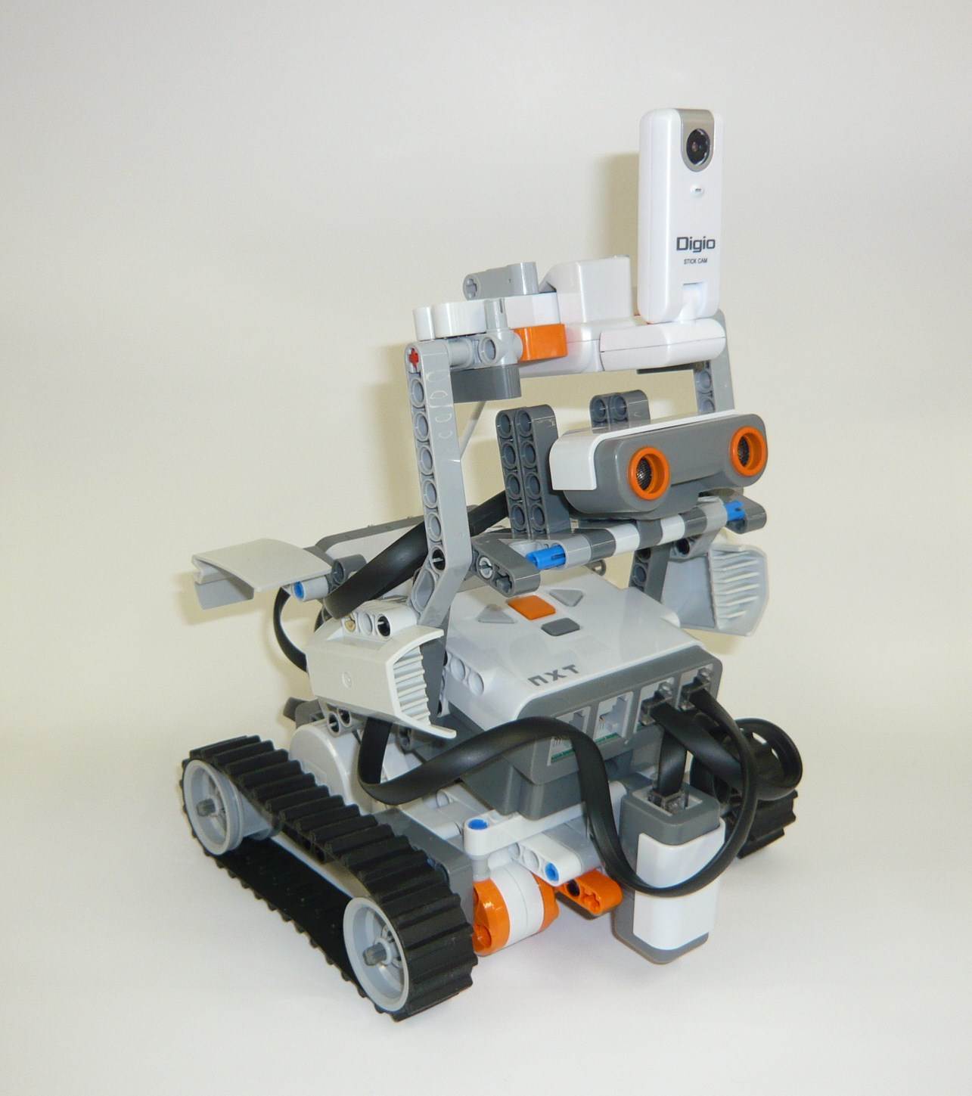
AC 1: Reception Robot
Fault Tolerant (2010)
Prepare a spare robot, and implement Fail-Over mechanism. By Fail-Over, in most cases, visitor only needs to wait 10 seconds when a failure occurs. In worst case (both robots are unavailable), visitor must wait 5 minutes.
Goal ``Robot recovers from failures within acceptable time”
Visitor
DB
Spare
Robot
Robot
Control
System
Visitor

Slide 9
Top Level
Effective for
Explicitly
Presenting
FT mechanism
Risk Analysis Results
Fault Tolerance
AC
Notes:
----- 会議メモ (10/12/07 11:14) -----
parallelgram

Slide 10
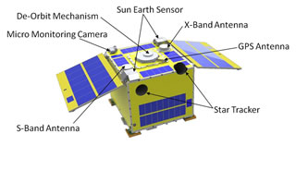
AC 2: Micro Satellite AC
(2013)
“Battery will never die”
The developer (MS student) himself wrote AC according to the V model development process
http://park.itc.u-tokyo.ac.jp/nsat/hodo2.html

Slide 11
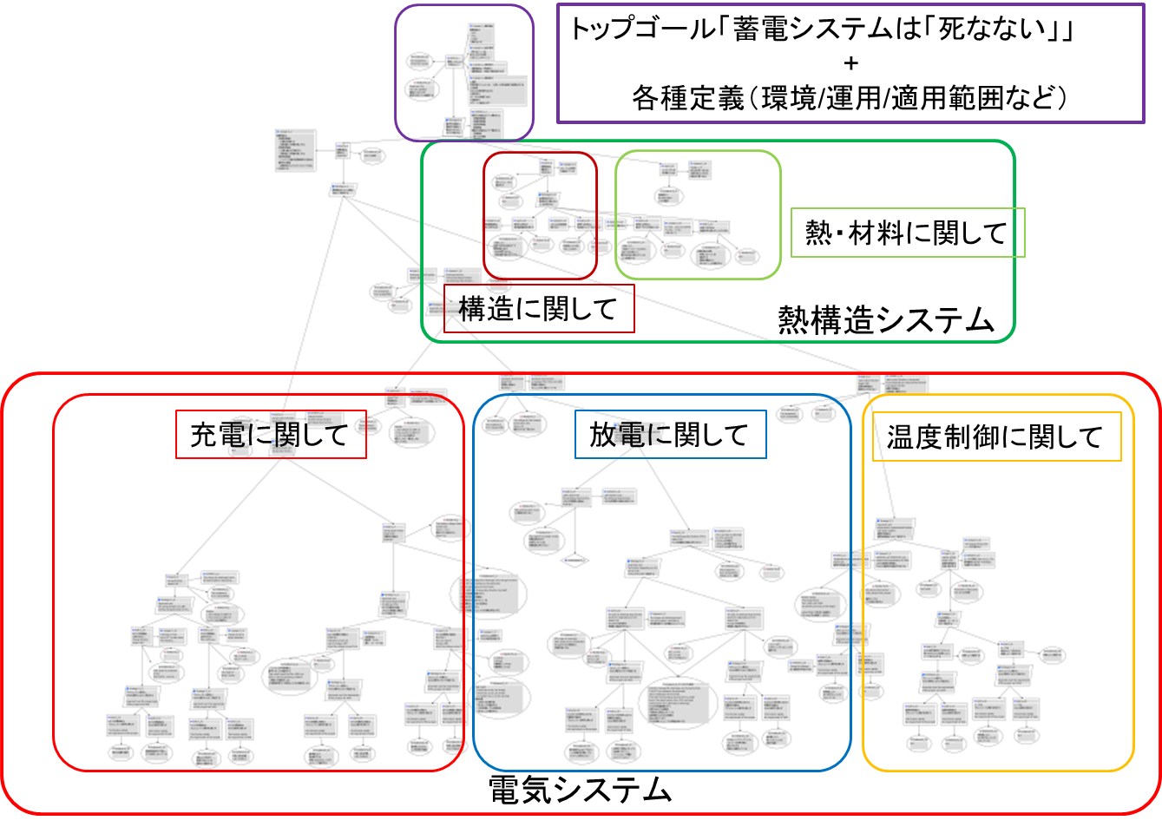
Micro Satellite AC
Battery will never die
Defs (Environment, Operation, NASA Req.)
２００ nodes,
1 month
Argument over
Structure based on
V development model
Heat System
Argument over
functions
Charge Function
Discharge Function
Temperature
Control
Function
FTA results are attached
as Evidence
System
AC
Other Engineers
evaluate this AC is
Good for traceability and
explanation
Electroic Sub System

Slide 12
AC 3: Mitsubishi Electronics
Relative Order
Parameter A
Result A
Parameter C
Parameter B
Simulator
Result B
Parameter A
Parameter C
Result C
Parameter B
Random
Number
User Chooses parameter
Simulator for setting relative order on Parameters
https://www.ipa.go.jp/files/000046465.pdf

Slide 13
Design
Implement
Testing
Implement
As designed
Design
Simulator
Test
Success!
Designer
Developer
Tester
This result is not
what I expected!!
(Experts knowledge)
Back to
Design Phase
Expert
https://www.ipa.go.jp/files/000046465.pdf

Slide 14
AC for Mitsubishi Simulator
(2014)
Simulator for
Setting relative order
Of parameters
Relative ordering
Of simulation parameters
Can be done
Explicitly show that
There are experts
knowledge
Argument with and without Experts knowledge
Relative ordering
Can be done in the
Condition when
Experts knowledge
exists
Relative ordering
Can be done in the
Condition when
Experts knowledge
Does not exist
Experts knowledge
documents
https://www.ipa.go.jp/files/000046465.pdf

Slide 15
Simple Observation
System AC
  General Goal: System is safe, secure, …
  Typical Arguments (Argument over sub systems,…)
  FTA, FMEA results as contexts and evidence
  Huge Cost -> Automation and Verification Needed
Situational AC
  Specific Goal: “Relative Ordering of Simulation Parameters can be done”
  Situation Dependent Arguments, 20~ nodes
  Low Cost

Slide 16
Situational AC
Mitsubishi Case
Relative Ordering of
Simulation parameters
Can be done
Designer
Expert
Situational
AC
Situational
AC
状況毎の
D-Case
状況毎の
D-Case
状況毎の
D-Case
状況毎の
D-Case
Situational
AC
Situational
AC
Situational
AC
Situational
AC
状況毎の
D-Case
状況毎の
D-Case
Situational
AC
状況毎の
D-Case
Situational
AC
状況毎の
D-Case
要求分析
仕様記述
設計
実装
評価
文書化
運用
Req Analysis
Specification
Design
Implement.
Evaluation
Document.
Operation

Slide 17
Answers for AC challenges?
When, who write and evaluate?
  In a situation, by Stakeholders in which assumption, culture may be different
  Ex. Automotive and Supplier Companies in design phase
Goal, Argument Structure
  Specific (not necessarily directly related to safety, security, …) and understandable for all stakeholders
Granularity, Size
  At most 20 nodes (in GSN), within a Power Point slide

Slide 18
Tool (DSN 2014 paper)
Design and Implement GSN tool
(D-Case Editor, www.dcase.jp )
  Formalize GSN community Standard using Functional Programming Language Techniques
  Pattern (parameter, loop, choice, multiplicity) and Module System
Design and implementation, and then verification

Slide 19
Concluding Remarks
Dependability is Consensus Building
  Assurance Case is a method for that
System AC (huge cost, automation and verification required) and Situational AC (lightweight, practical)
Notes:
すり合わせ開発

Slide 20

Concluding Remarks
DEOS Consortium
  www.deos.or.jp
D-Case Working Group
  www.dcase.jp
  Started writing Situational AC with Japanese Automotive companies
D-Case Certification Scheme started in 2015.6
  D-Case Syntax (Based on DSN2014 paper)
  Astah/GSN Certified!
  D-Case Syllabus Denso Create Certified!
D-Case
Project
Logo

Slide 21
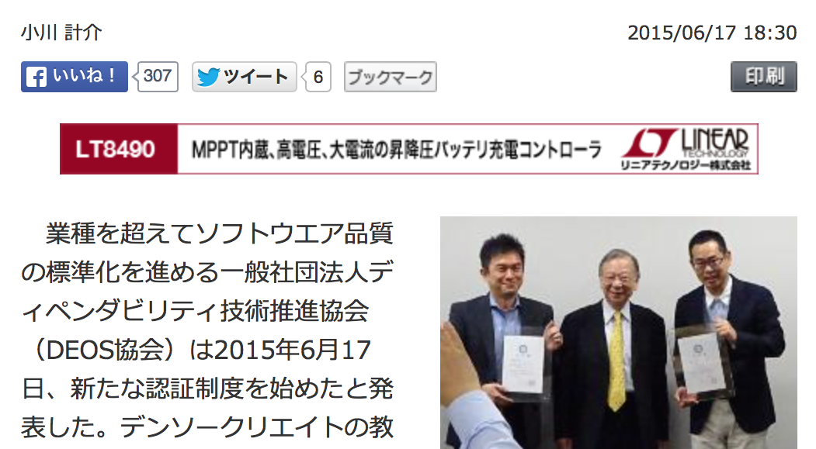
News of D-Case Certification

